Slide 1

IT Talents Season 7 Final Project
www.freeagents.eu/FreeAgentsFinal
Created by:
Pavel Damyanov
Mario Yordanov

Slide 2

About the project
In short, a website, which allows you to post jobs as employer or send offers for a job as freelancer.

Slide 3
Functionalities
Login
Forgotten Password
Signup
Send Welcome e-mail
Logout
View/Edit My Profile
Change Password
Upload profile picture
My Messages – Inbox, Sent, Send/Reply
My Feedbacks, My Jobs
Jobs I am working
View User’s Profile
View All Jobs From User
Browse jobs – sort by budget asc/desc; by category; by required experience; by date
Post job
Send, Receive and Accept Offer
Leave one single Feedback when Job Finished
Notifications for new Message, Feedback, Offer, Accepted Offer
Contact Us – Google Maps API

Slide 4

Technologies used
Server: Apache Tomcat
VCS: GIT
DB: MySQL
Spring Framework/ Spring MVC
Database Caching
Java
JavaScript
CSS
JSTL
Design Patterns: DAO, Singleton
POJO
Java Mail
Google Maps API
BCrypt Hashing Algorithm

Slide 5
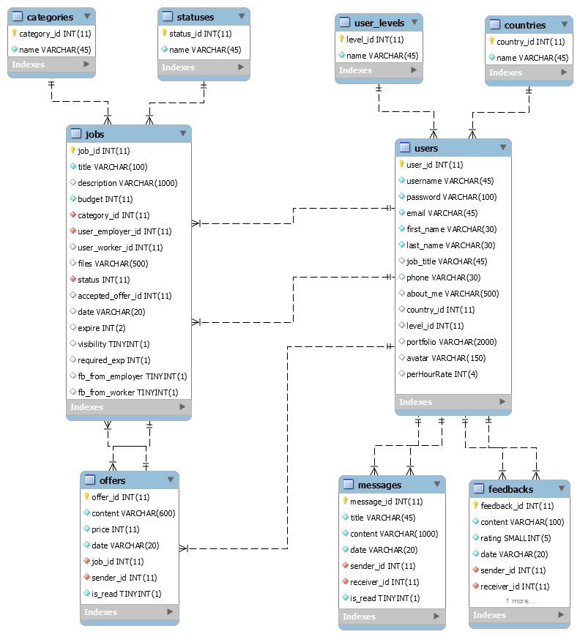

Slide 6


Slide 7

Future plans
Login/Signup with LinkedIn account
Implementing payment system for promoting your Jobs and paying to the freelancer
Implementing a ticket system – so the employer will be able to receive a refund if the employee hasn’t completed the job
Business Cost Calculator
Virtual office

Slide 8


